Slide 1
Interoperability in the Collaborative Medical Information Systems
Dragan Janković, Ivica Marković
Faculty of Electronic Engineering
University of Niš

Slide 2
Contents
About Medical Information Systems
Healthcare system in the Republic of Serbia
MEDIS.NET project and MIS interoperability
Examples of integration at different levels

Slide 3
Medical Information Systems (MIS)
Information Systems used in everyday practice of healthcare institutions
Result of an intersection of information science, computer science and healthcare
Main task is to optimize the acquisition, storage, retrieval and use of information in healthcare
Applied to the areas of nursing, clinical care, dentistry, pharmacy, public health, (bio)medical research etc.

Slide 4
Medical Information Systems (MIS)
Typical software modules in a MIS include electronic health record (EHR), financial reporting module, module for handling images etc.
Users:
Healthcare personnel
Healthcare service users
Teachers and students
Goals:
Efficient operating of healthcare institutions
Quality improvement of healthcare services
Costs reduction at healthcare institutions
Better education of medical personnel
New possibilities for scientific work in medicine

Slide 5
Contents
About Medical Information Systems
Healthcare system in the Republic of Serbia
MEDIS.NET project and MIS interoperability
Examples of integration at different levels

Slide 6
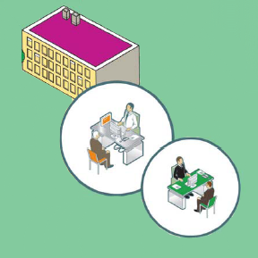
Health care system in Serbia
Structure:
Public healthcare system offering universal healthcare
Private practices - relatively small and differentiated
Public healthcare system provides 3 levels of health protection:
Primary level – 158 healthcare
centers
Secondary level – 77 hospitals
Tertiary level – clinics, clinical centers,
institutes etc.

Slide 7
Health care system in Serbia
Healthcare system is managed by the following 3 institutions:
Ministry of Health of Republic of Serbia – creating and executing healthcare politics
Institute of Public Health of Serbia
“Dr Milan Jovanović Batut” – public health
analysis and suggestions for improvements
Republic Institute for Health Insurance
(RZZO) – defining healthcare services and
funding healthcare institutions

Slide 8
MIS in Serbia
Public healthcare system has a complex organization and numerous operational inefficiencies, so it needs significant information technology support to perform better
The main problems are the dependence on large amounts of paper documents and the complexity of procedures/processes
Members of medical personnel spend a lot of time on basic paperwork

Slide 9
MIS in Serbia
Since 2001 Ministry of Health has been making significant efforts to introduce IT in the public healthcare system
Biggest issue was lack of required hardware and it is mostly solved now
A number of institutions have introduced MIS
Currently the only MIS software component that works in each medical facility and is truly interoperating is the financial reporting system
There is no interoperation and collaboration (exchange of patient medical information) between primary (ambulatory) and higher levels of healthcare

Slide 10
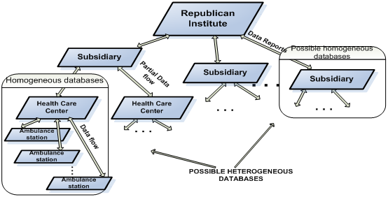
Data exchange in Serbian healthcare system

Slide 11
Contents
About Medical Information Systems
Healthcare system in the Republic of Serbia
MEDIS.NET project and MIS interoperability
Examples of integration at different levels

Slide 12
MEDIS.NET project
Developed at Faculty of Electronic Engineering in Niš in cooperation with Healthcare Center in Niš
The project has been supported and funded by the Ministry of Science and Technological Development since 2008 (project TR-13015)
http://medisnet.elfak.ni.ac.rs
A complete MIS for primary levlel of health care (general practise, laboratory, dentistry, radiology, financial reporting...)
Also contatins a part of MIS for secondary level (clinic for neurology) with information exchange between primary and secondary level

Slide 13
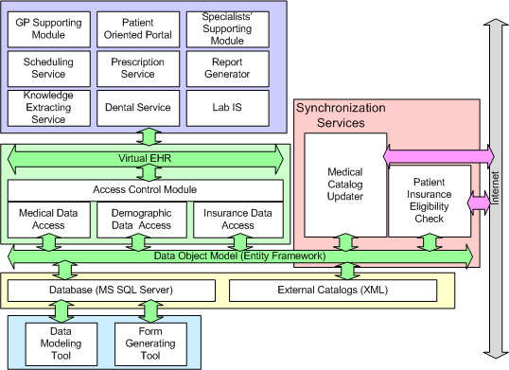
MEDIS.NET project - arhitecture

Slide 14
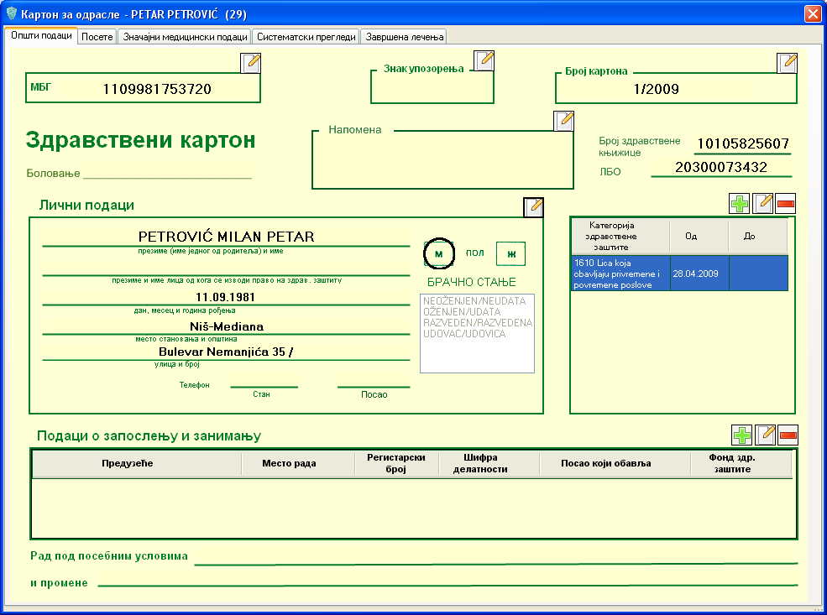
MEDIS.NET project – user interface

Slide 15
Integration and interoperability
An information (personal data, health ensurance data, medical data) should be entered only once and available when required
Controled access to private and confidential data through user privileges mechanism
Integration of applications for various departments (for example applications for laboratory and radiology can be used as stand-alone applications or as parts of an integrated system)

Slide 16
Integration and interoperability
Widely adopted international standards:
openEHR - open standard specification that describes the management and storage, retrieval and exchange of health data in EHRs;
ICD-10 - International Statistical Classification of Diseases and Related Health Problems, 10th revision provided by the World Health Organization;
DICOM - Digital Imaging and Communications in Medicine.
Locally defined standards of communication through XML and Web Services
Codebooks and catalogs provided at the state level

Slide 17
Contents
About Medical Information Systems
Healthcare system in Republic of Serbia
MEDIS.NET project and MIS interoperability
Examples of integration at different levels

Slide 18
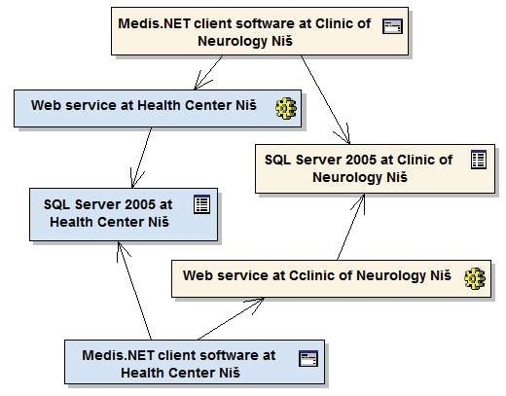
Example: Interoperability between primary and secondary healthcare institutions

Slide 19
Example: Laboratory IS integration

Slide 20
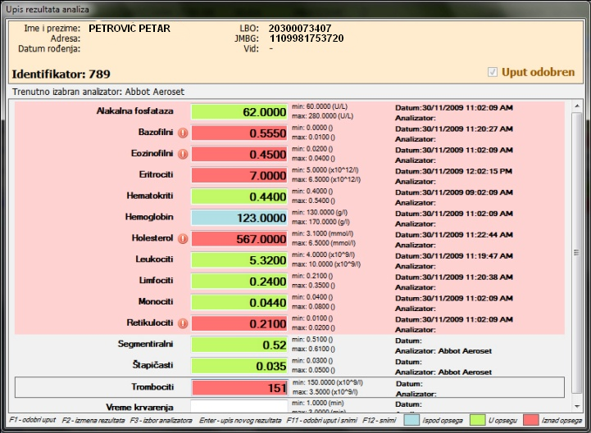
Example: Laboratory IS integration

Slide 21
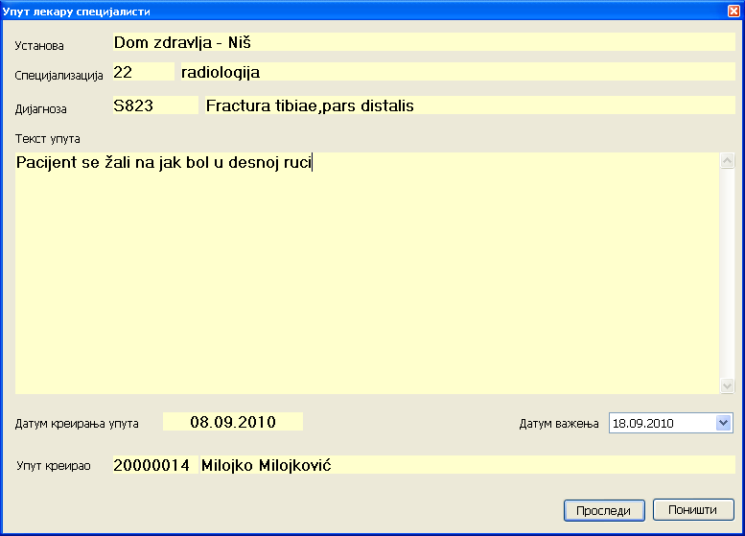
Example: Integration of Radiology IS

Slide 22
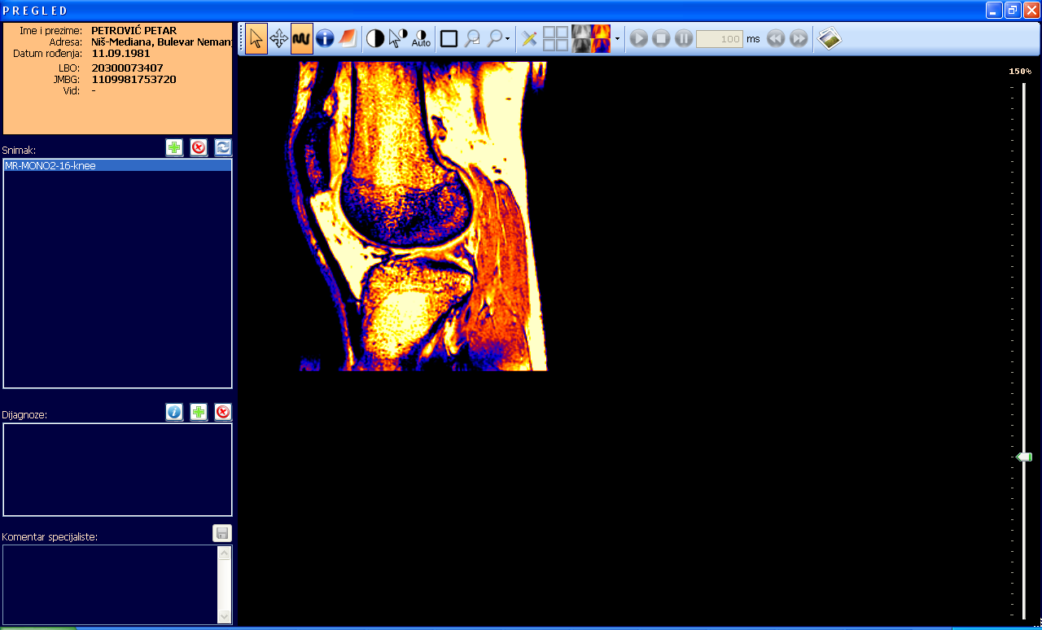
Example: Integration of Radiology IS

Slide 23
Thank you!
Questions?

